Slide 1
WORKPLACE PROFESSIONAL COMMUNICATION SKILLS
WORKPLACE LANGUAGE SKILL
- Effective Listening Skills
- Assertiveness
- Effective working in group
Notes:
2 to 7 minutes
Allow 2 minutes to introduce the topic and instructor(s).
Provide some background on yourself and introduce the topic. And thank them for participating in the session.
If the class size is not too large, then allow an additional period for self introductions (name, year in school). This should be no more than 5 minutes. Total 2 to 7 minutes.
Room Set-up, Preparation and Materials
Ideally, if you have control of the room arrangement, round tables would be the best set-up to allow for a group exercise. But if you are in a classroom set-up that does not allow for any changes you will have to conduct the session as is. Find out the room set-up so you can plan ahead.
To conduct the session you will need:
Projection screen, projector and extension cords (most classrooms have built in a/v systems)
Laptop (with remote if possible)
1 Flip chart, markers and masking tape
Handout materials
Paper and pens for the participants (optional for the group session)
An assistant – this could be one of the student organizers or a volunteer from the audience
This person’s role is to record responses on the flip charts and then tape the flip charts to the wall during the session (You want to remain free to facilitate the session

Slide 2
Learning Objectives
To learn how to listen effectively in class and in life
Develop students listening abilities,
Teach basic listening strategies,
Address difficulties faced in effective listening, and
Expose students to different listening situations through activities.
Notes:
1 minute
State the main goal of the session is to help students further their academic success by becoming better listeners. You can then list the main learning objectives of the session:
To develop the global listening abilities of students,
To teach them a few basic listening strategies,
To remove the flaws the students might be facing in effective listening, and
To expose them to a number of different listening situations through activities.

Slide 3

The following saying summarizes the importance of listening: "We have two ears and one mouth so that we can listen twice as much as we speak.“
Notes:
3 – 5 minutes
This slide is meant as an introduction. The quotes are animated on the mouse. Click or advance.
Ask the students their thoughts on the quote. Do they agree or disagree? Ask them why?
Have a co-presenter or an assistant track the comments on a flip chart.

Slide 4
What is Effective Listening?
Effective listening skills
ability to actively understand information provided by the speaker
display interest in the topic discussed.
It can also include providing the speaker with feedback, by asking pertinent questions so the speaker knows the message is received.
Effective Listening is a skill using multiple senses to comprehend the message being sent by the speaker.

Slide 5
Listening: as a communication skill
Listening is one of the most important communication skills
We probably spend more time using our Listening Skills than any other kind of skill
Like other skills, Listening takes practice
Real Listening is an active process
Listening requires attention

Slide 6
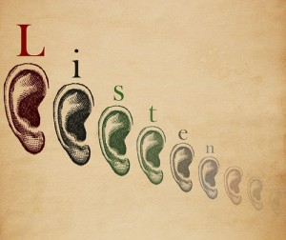
Characteristics of Listening
L = Look interested
I = Involve yourself by responding
S = Stay on target
T = Test your understanding
E = Evaluate the message
N = Neutralize your feelings

Slide 7
10 Steps to Effective Listening
Step 1: Face the speaker and maintain eye contact.
Step 2: Be attentive, but relaxed.
Step 3: Keep an open mind.
Step 4: Listen to the words and try to picture what the speaker is saying.
Step 5: Don’t interrupt and don’t impose your “solutions.”
Notes:
1 minute
Because the reality is that in engineering, effective communication will be crucial to your success. And that realization many engineers face as they begin their careers.
In fact, there is a saying that, “In engineering, you’ll only go as far as your communications skills will take you.”
And a recent survey conducted by ASME confirmed that. The respondents indicated that communications skills are crucial for success

Slide 8
10 Steps to Effective Listening (2)
Step 6: Wait for the speaker to pause to ask clarifying questions.
Step 7: Ask questions only to ensure understanding.
Step 8: Try to feel what the speaker is feeling.
Step 9: Give the speaker regular feedback.
Step 10: Pay attention to what isn’t said—to nonverbal cues.
Notes:
1 minute
Because the reality is that in engineering, effective communication will be crucial to your success. And that realization many engineers face as they begin their careers.
In fact, there is a saying that, “In engineering, you’ll only go as far as your communications skills will take you.”
And a recent survey conducted by ASME confirmed that. The respondents indicated that communications skills are crucial for success

Slide 9




The Process of Listening can be categorized into 4 main areas
Hear
Clarify
Interpret
Respond

Slide 10
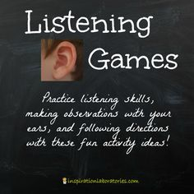
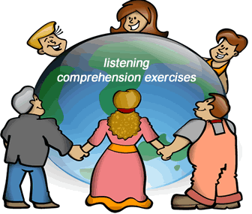
Listening Exercises
Notes:
10 – 12 minutes
This is an exercise for the entire group.
Materials
• One sheet of paper (8-1/2 x 11) for each participant
• One sheet of paper for the facilitator
Before going into the next section on presentations, I wanted to conduct a little communication exercise. During the discussion on reports, we talked about the section where you described what took place. That was an important part of the report because it enables people to replicate what you did. Being able to communicate that type of information effectively is necessary for every type of communication, not just reports, but in presentations, papers and even just verbally between to or more people. So this demo is to meant to show you the challenges in being an effective communicator.
So let’s start.
Directions
After giving each participant one sheet of paper, offer the following directions, pausing
after each instruction to give the group time to comply (complete the activity yourself
using your own sheet of paper).
1. Pick up your sheet of paper and hold it in front of you. Close your eyes and listen carefully to my directions. The rules are: (1) no peeking and (2) no
questions.
2. The first thing I want you to do is to fold your sheet of paper in half. (Pause)
3. Now, tear off the upper right hand corner. (Pause)
4. Fold the paper in half again and tear off the upper left hand corner of the sheet. (Pause)
5. Fold it in half again. (Pause)
6. Now tear off the lower right-hand corner of the sheet. (Pause)
After all tearing is complete, say:
Now, open your eyes and unfold your paper. If I did a good job of communicating and you did a good job of listening, all of our sheets should look exactly the same!
Hold your sheet up for everyone to see. Ask participants to compare their sheets. Ask why no one’s paper matched yours exactly?
You will probably get responses such as, “You didn’t let us ask any questions!” or “The way you gave us directions wasn’t clear!”
Part of the communication process (and being a good communicator) is recognizing that people may need to receive information in different ways in order to be successful. Remember that someone reading your report or paper can’t ask you any questions. So you need to become a better communicator to avoid a misinterpretation of what your wrote or what you said.
Remember, I never said in the directions that I wanted all your papers to look alike at the end. But what if I had made that the objective? What suggestions do can you think of that would have improved my directions?
Track the results on a flip chart. Gauge your time and how much discussion you want before going onto the next session.
To close:
Think about the suggestions that were made and when you are writing or developing a presentation, think about the audience. What will you need to include so the audience receives and understands the information as you intended? Now let’s move on to Presentations.

Slide 11
Listening Exercises: Games to Improve Attention
Paying close attention to a speaker is the first requirement of active listening. Maintaining attention isn’t easy, especially when the speaker or topic isn't interesting. Improve attention skills with games that require players to observe and remember details.
Matching games -- like those that require players to remember the location of concealed images or find discrepancies between identical pictures

Slide 12
Listening Exercises: Additional Resources
http://blog.trainerswarehouse.com/communication-and-listening-exercises/
https://blog.udemy.com/listening-skills-exercises/

Slide 13
ASSERTIVENESS
“

Slide 14
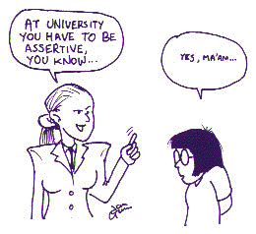
WHAT IS ASSERTIVENESS?
Assertiveness is about self confidence which means having a positive attitude towards yourself and others.

Slide 15
Ten Points about Assertive Behaviours
1-It depends on expressing yourself
2-Showing respects to others rights
3-Being honest
4-Indirect and certain
5-Mutual equilibrim and benefit is important in a relationship
6-It is expressing emotions, rights, realities, thoughts and boundaries by words
7-Using non-verbal comminication for sending the message
8-It is not universal, it depends on the position and the individual
9-It is getting social responsibility
10-It is not the nature of the hunamkind, it can be learned

Slide 16
Being Assertive
1-Being assertive is focusing on your goal
2-Being assertive is being self-aware
3-Being assertive is being true to yourself
4-Being assertive is building self esteem
5-Being assertive is nurturing yourself.

Slide 17
3-TYPES OF ASSERTIVENESS
Non-assertive behaviour
I am not ok,you are ok
Assertive behaviour
I am ok,you are ok
Aggresive behaviour
I am ok,you are not ok
Manipulative behaviour
I am not ok,you are not ok

Slide 18
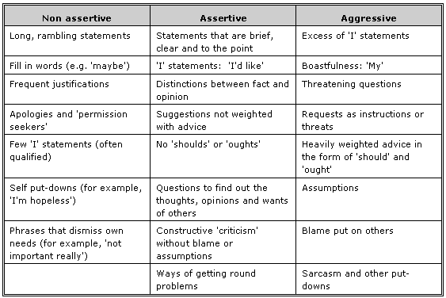

Slide 19
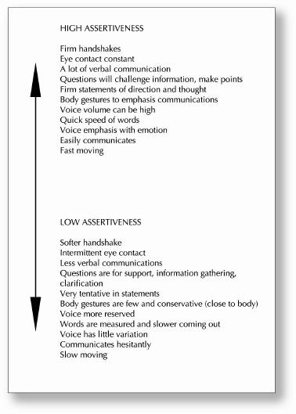

Slide 20
THE IMPORTANCE OF ASSERTIVENESS IN ORGANISATIONS
Assertiveness
Personal identity
Wages or salary
Satisfaction from exercising skills
Satisfaction from helping people
Social environment
Need to dealing with
Theirselves
The manager to whom they report
Their colleagues
Their subordinates
Clients or customers

Slide 21
10-ASSERTIVENESS TRAINING IN WORK PLACE
Body-language awareness leading to work body oriented therapies
Role-plays and then work in psyhcodrama
Awareness of other people’s perceptions and so work in sensitivity groups and encounter
Looking at situations in the past where one was, or was not assertive and hence traditional psychoteraphy

Slide 22
TO DECİDE WHEN TO BE ASSERTİVE
Do you know really what is the situation?
How much importance it has for you?
Will you get what you want?
Do you want to just express yourself?
What is your options?
Do you want an optimistic result?
Are you ready to be assertive?
Did you count to the 10?
Is it beter to wait?
Will you get anger to yourself, ,f you don’t do anything?
Have you done your best?
What are the possible results and risks?
Will assertiveness cause a change?

Slide 23
Effectiveness Working in Group

Slide 24
Games
https://www.wrike.com/blog/team-building-games/
http://www.refreshleadership.com/index.php/2012/08/quick-games-engage-employees-work/
https://toggl.com/team-building-games/

